Slide 1
The cell biology lab 7
The cell coats and chloroplast

Slide 2
Cell coats:
* Cell coat is a covering over the plasma membrane of most animal cells. It consists of glycoprotiens and polysaccharides and has a chemical composition that differs from comparable structures in either plants or bacteria.

Slide 3
* The cell coat provides a biochemical identity at the surface of the cells and these forms of cellular identity are under genetic control.
* Cell wall is a characteristic feature of plant cells, bacteria and fungi. The composition however varies in different groups

Slide 4
In plant cell, It composed of cellulose insoluble polysaccharides (like pectin, hemicellulose, lignin and xylan may also be present).
* The cell wall consist of two layers primary wall and secondary wall.

Slide 5
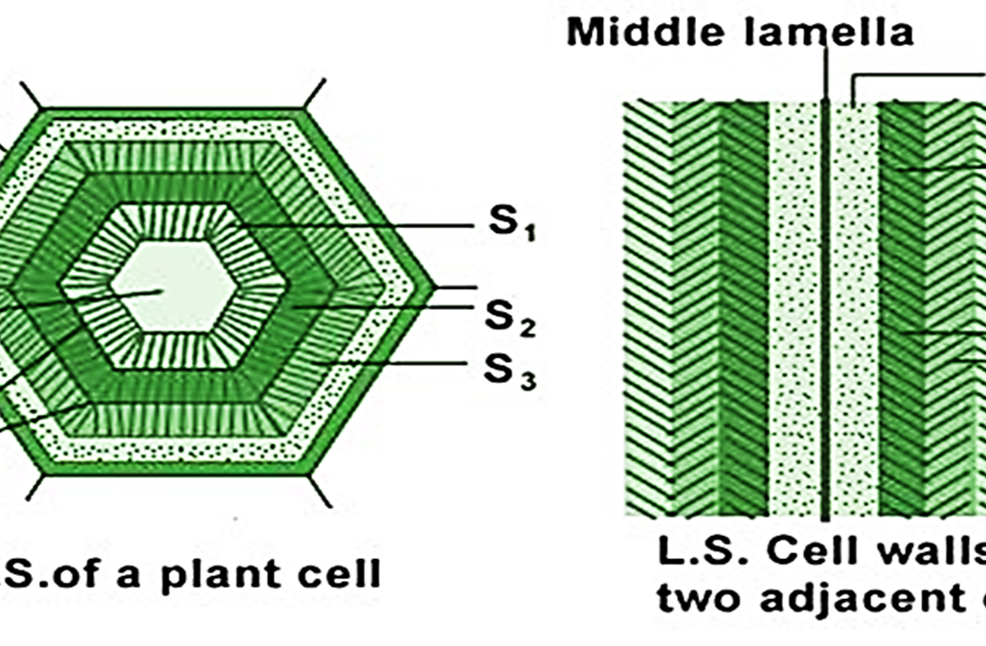

Slide 6
* Glycocalyx: is surrounds the cell membranes of some bacteria, epithelia and other cells. Consists of complex carbohydrates bonded to the proteins and lipids in the plasma membrane.

Slide 7
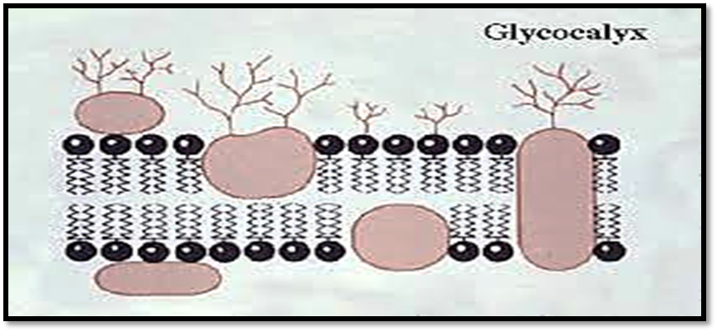

Slide 8
Functions of glaycocalyx
1. Molecular Recognition.
2 . Filtration .
3 . Enzymatic function.
4 . Microenvironment.

Slide 9
Glycocalyx | Cell wall
Also | Located outside of the plasma membrane
Also | Composed of carbohydrate
Thin flexible layer | Rigid structure
Found in animal cells | Found in plants
Also | Protect the cell

Slide 10
plastids
Plastids are organelles which are bounded by double membranes and which occur, as far as is known, in all cells of eukaryotic green plants at some stage, usually becoming modified according to their function. In their undifferentiated form, they may remain as proplastids, for example. In the green parts of plants, the proplastids normally develop into chloroplasts, which are the site of photosynthesis while in starch storing organs they form amyloplasts, which produce the starch grains.

Slide 11
Chloroplast
The organelles are only found in plant cells and some protests such as algae. Animal cells do not have chloroplasts. Chloroplasts work to convert light energy of the Sun into sugars that can be used by cells, this process called photosynthesis and it all depends on the little green In the process of photosynthesis, plants create sugars and release oxygen (O₂). The oxygen released by the chloroplasts is the same oxygen you The chloroplasts are double membrane bound organelles and they have a system of three membranes: the outer membrane, the inner membrane and the thylakoid system chlorophyll molecules in each chloroplast.
The chloroplasts are double membrane bound organelles and they have a system of three membranes: the outer membrane, the inner membrane and the thylakoid system.

Slide 12
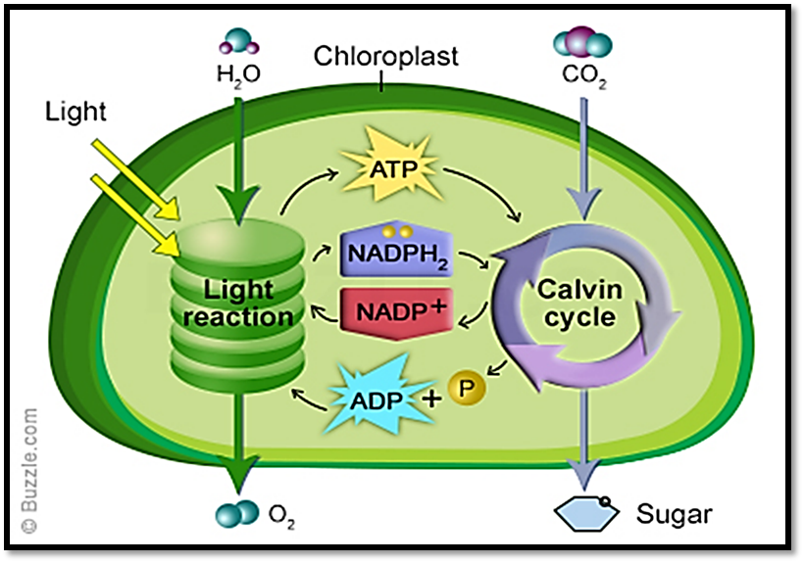

Slide 13
The inner membrane surrounds
1- The stroma (is an alkaline, aqueous fluid, which is protein rich and the space outside the thylakoid space).
2- The grana (stacks of thylakoids), one thylakoid stack is called a granum The chlorophyll is found in the thylakoids and is the sight for the process of light reactions of photosynthesis to happen.

Slide 14
